Slide 1
Race of Doom
Sdmay-24-06 Andy Nguyen, Aaron Gienger, Ben Dubin, Blake Carlson, Carson Tow
Notes:
Intro

Slide 2
Intro/Background
Our Goal:
Build a small remote-controlled car that can operate autonomously. The car should navigate through an indoor track avoid any potential traps set by the track team.
The vehicle should be built to be durable and protected enough to successfully complete the race. If possible, the vehicle should try to complete the race in a timely manner and win against the other team’s vehicle.
Notes:
Talk about team structures(track team and 2 car teams) Ben

Slide 3
Intended Users
This semester
The active senior design teams
Professor Bigelow
Future
Use in similar senior design projects
Eventually could be implemented into a embedded system class
Similar to Cpre 288: Introduction to Embedded Systems
Notes:
Carson

Slide 4
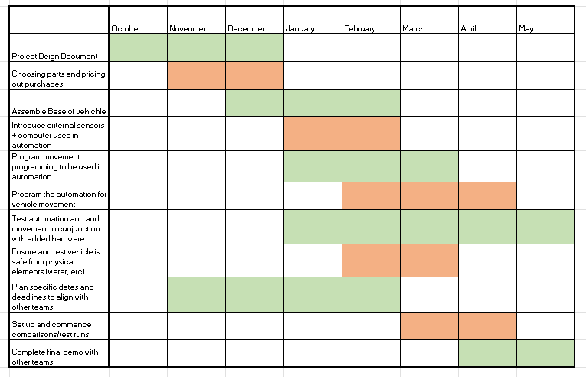
Project Plan
Notes:
Carson

Slide 5
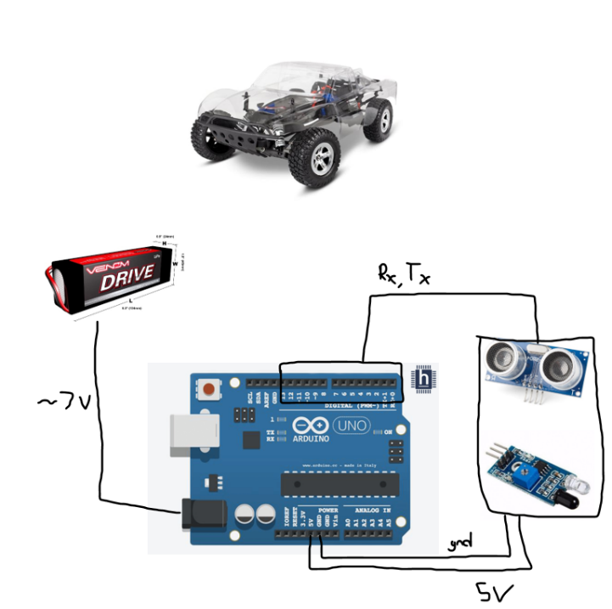
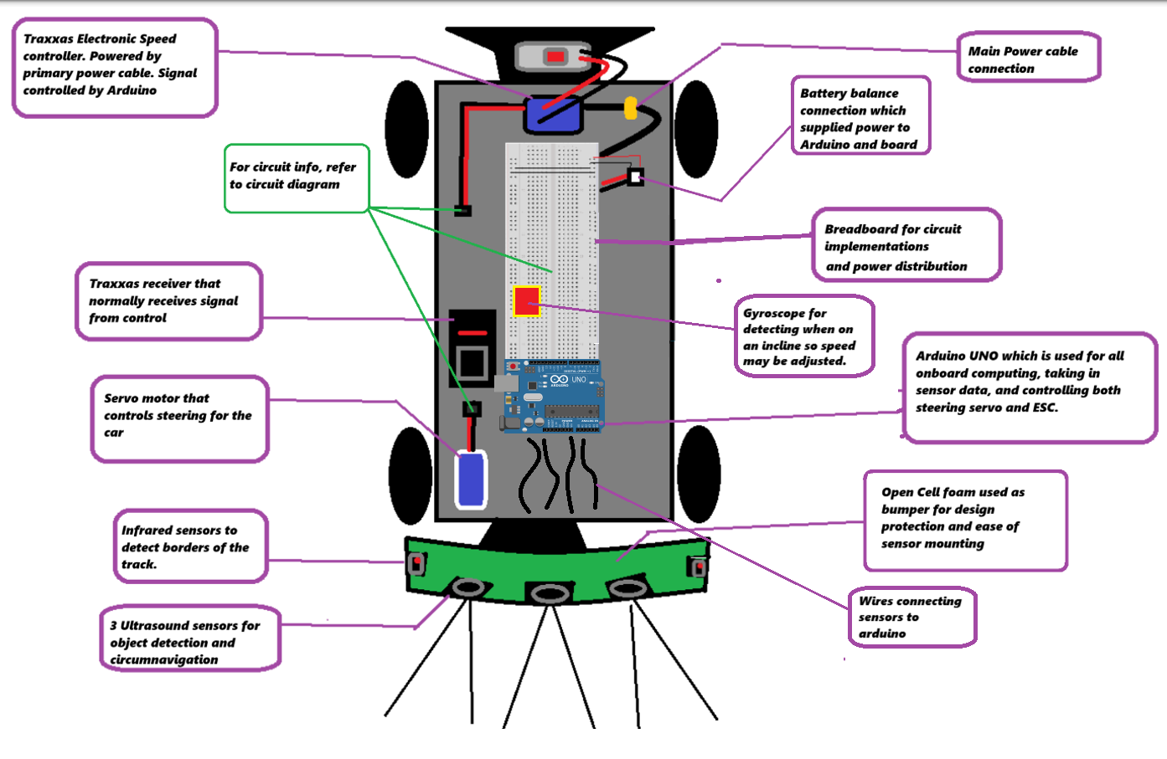
Design
Original Ideas/Design…
Microcontroller - Arduino
Object Detection - Ultrasound
Line Detection - IR/Photosensitive Sensor
Car Base - Traxxas Slash
Added over time…
Elevation Detection - Gyroscope
Read/Run - Button
Front Bumper Mount
Removal of Photosensitive Sensor
Initial Rough Design vs Final Design
Notes:
Ben

Slide 6
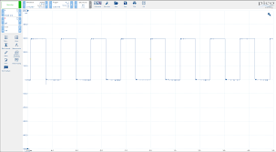
Complications and Challenges
Port limitations
ESC calibration
Battery failure
Ir sensor/Photoelectric sensor detection
Component mounting
Ramp introduced by track team
Edge cases in algorithm
Notes:
Blake

Slide 7
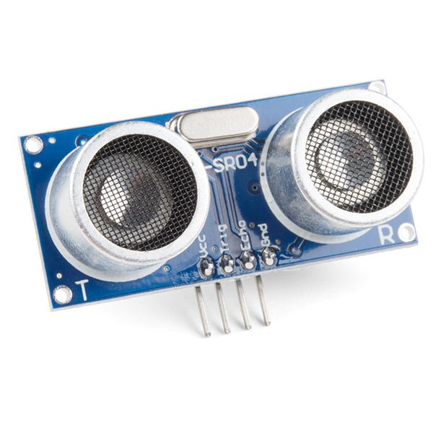
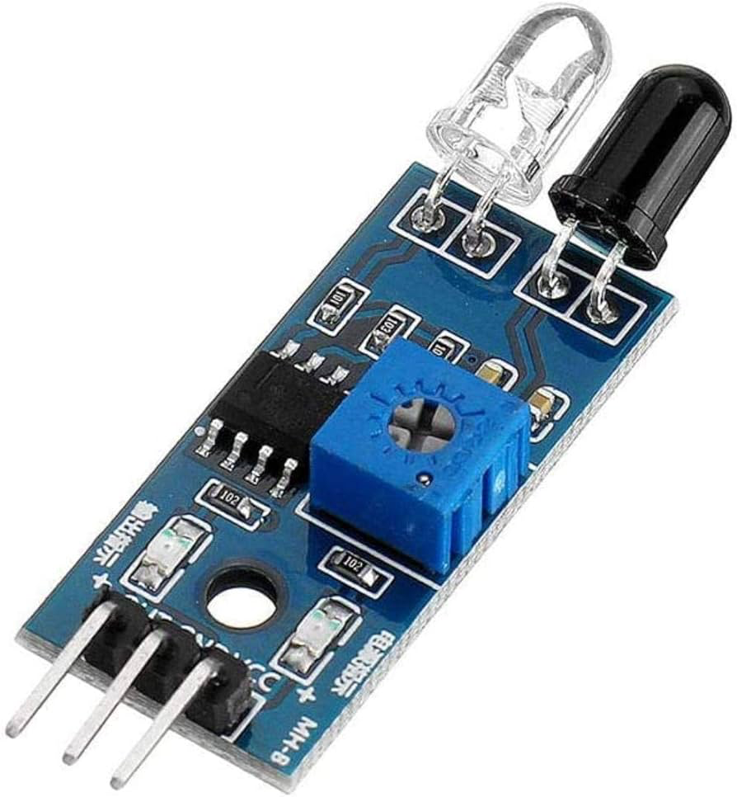
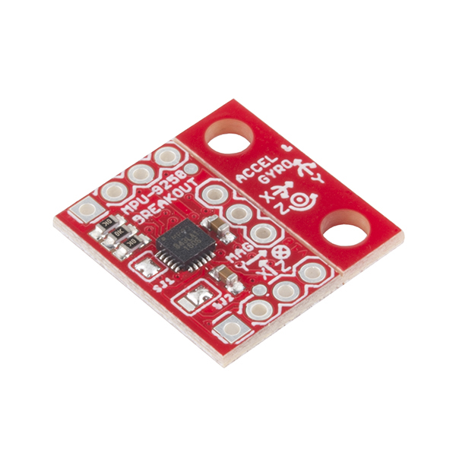
Testing & Prototyping
Ultrasound - Ranges, sensor angles, object detection tests
IR Sensor - Contrast tests and ranges
ESC - values and calibration sequence
Gyroscopic Sensor - Range and calibration
Software testing and refinement
Notes:
Blake

Slide 8
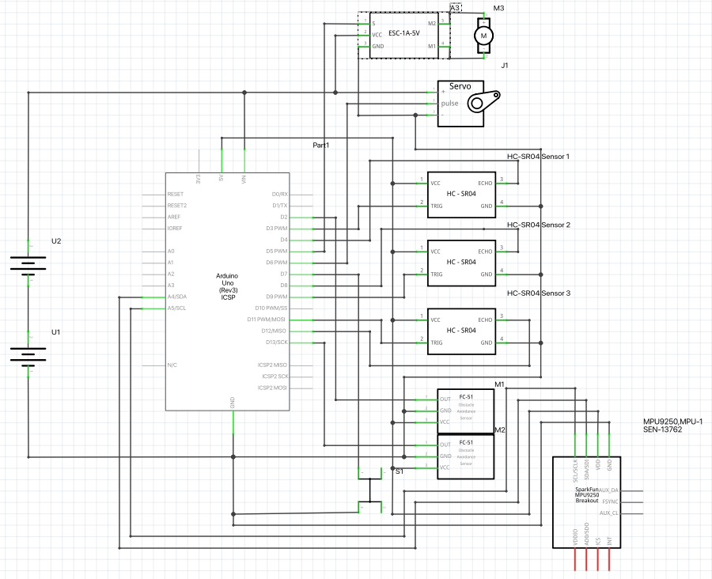
Final Project Diagram
Notes:
Andy

Slide 9
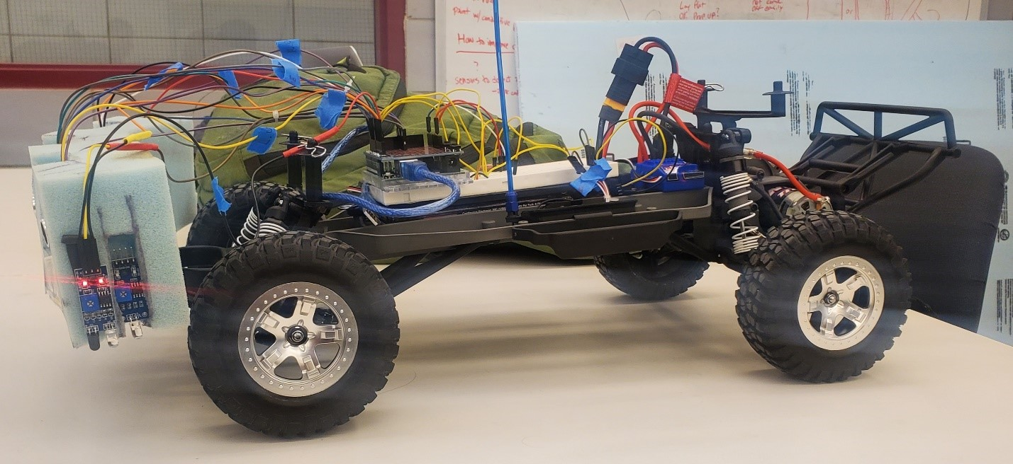
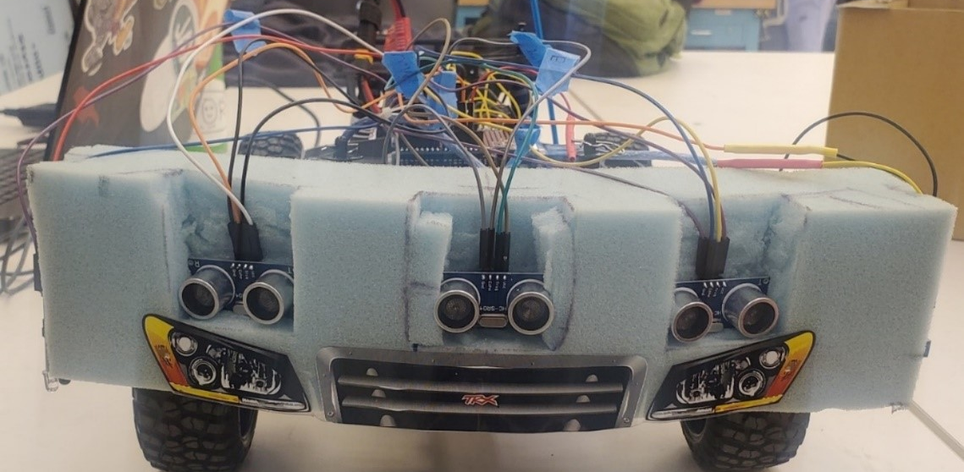
Final Design
Notes:
Andy

Slide 10
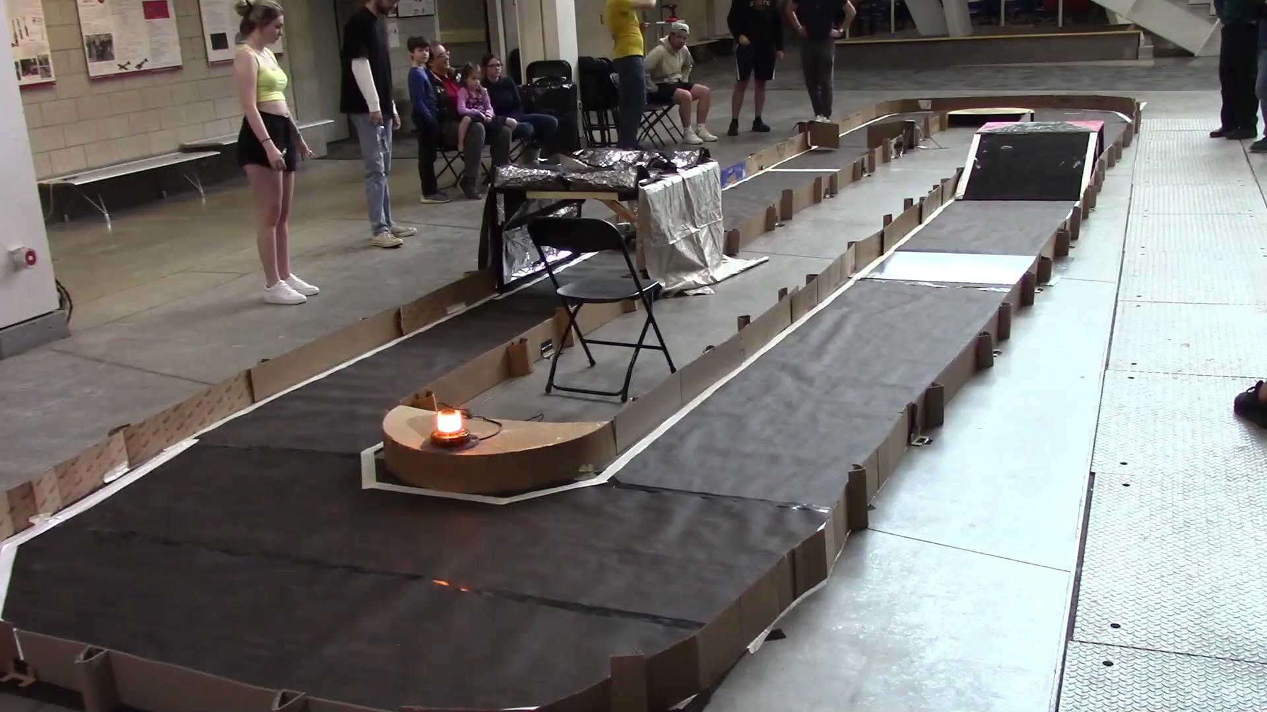
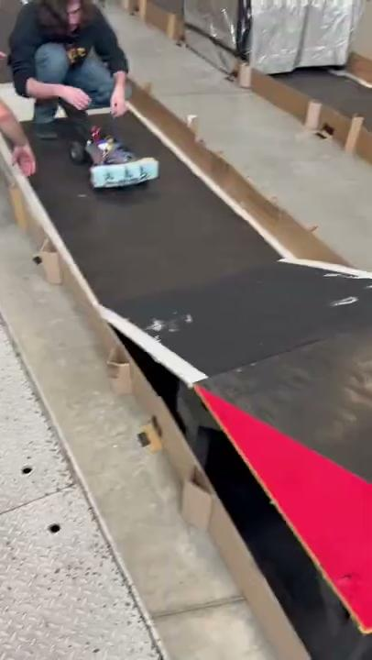
Demos of Track Navigation Functionality
Notes:
Demo, Talk through turning and ramp algorithm

Slide 11
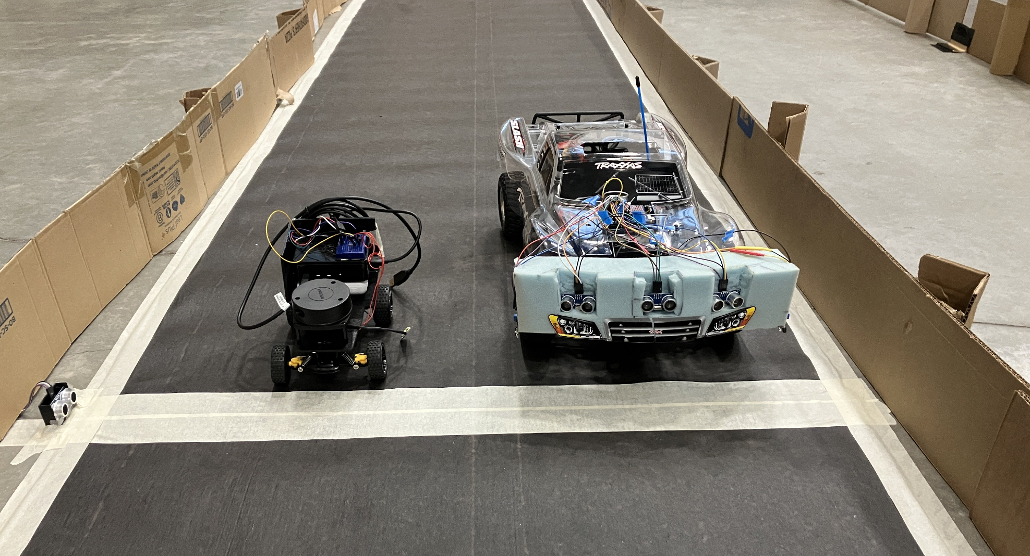
Race Results
Our “Opponent”
Smaller/Cheaper Car
Semi-Autonomous not Fully
Uses one lidar sensor
We did 3 “Official” race laps
Time trial style
Took each team’s best run
Time Penalties for Mistakes/Corrections
Who won?
Notes:
Aaron

Slide 12
Conclusion
Gained an understanding of basic autonomous vehicle design and implementation
Designed and coded an algorithm to drive around the given track
Managed working in a team with conflicting schedules and coordinating with other teams
What would do differently if possible?
Notes:
Aaron
Diff if possible(Wifi Arduino, Clarity in track design, Bigger Budget)

Slide 13
Any Questions?

